Slide 1
[COMPANY NAME] Meeting with
[PAYER NAME]
DRAFT 11/17/23

Slide 2
Agenda
Introductions and Goals
Life of an Order
Challenge 1: Cost of Goods (COGs)
Challenge 2: Supply Chain and Shipping
Challenge 3: Operational Expenses
True Cost of an Item
HME Provider Value
Questions and Next Steps

Slide 3
Introduction and Goals

Slide 4
PURPOSE: To introduce the HME provider to the and emphasize the VALUE of HME
HME Provider Intro Slide(s)
[Insert HME Provider logo]
[Company Name] Background
- Years in business
- Product categories and geographic reach
- Market strategy (stats specific to census and payer if applicable)
Value of HME
- Resources: AAHomecare Value of HME brochure with videos

Slide 5
PURPOSE: Lay out the HME Provider’s goals for the discussion/negotiation with the payer
HME Provider Goals
List what HME Provider wants to accomplish during this discussion/negotiation (rate increases, network access, etc.)
List the HME Provider’s motivation for the discussion/negotiation

Slide 6
PURPOSE: To lay out the Payer’s goals for the discussion/negotiation
TIP: Try to obtain this pre-meeting. If not, allow time to ask the payer’s goals & motivations
Payer Goals
What is most important to the payer in terms of a relationship with a HME Provider (formulary driven, patient outcomes focus, product category pain points, etc.)?
What is the payer’s motivation for the discussion/negotiation?

Slide 7
PURPOSE: Review of existing relationship (program structure, fee schedule, etc.).
Ask the payer for their feedback from their vantage point of pros and cons.
HME Provider/Payer Relationship Today
List current relationship specs, keeping it factual
Provide high level mention of pros and cons of the relationship from the HME Provider perspective.

Slide 8
Life of an Order

Slide 9
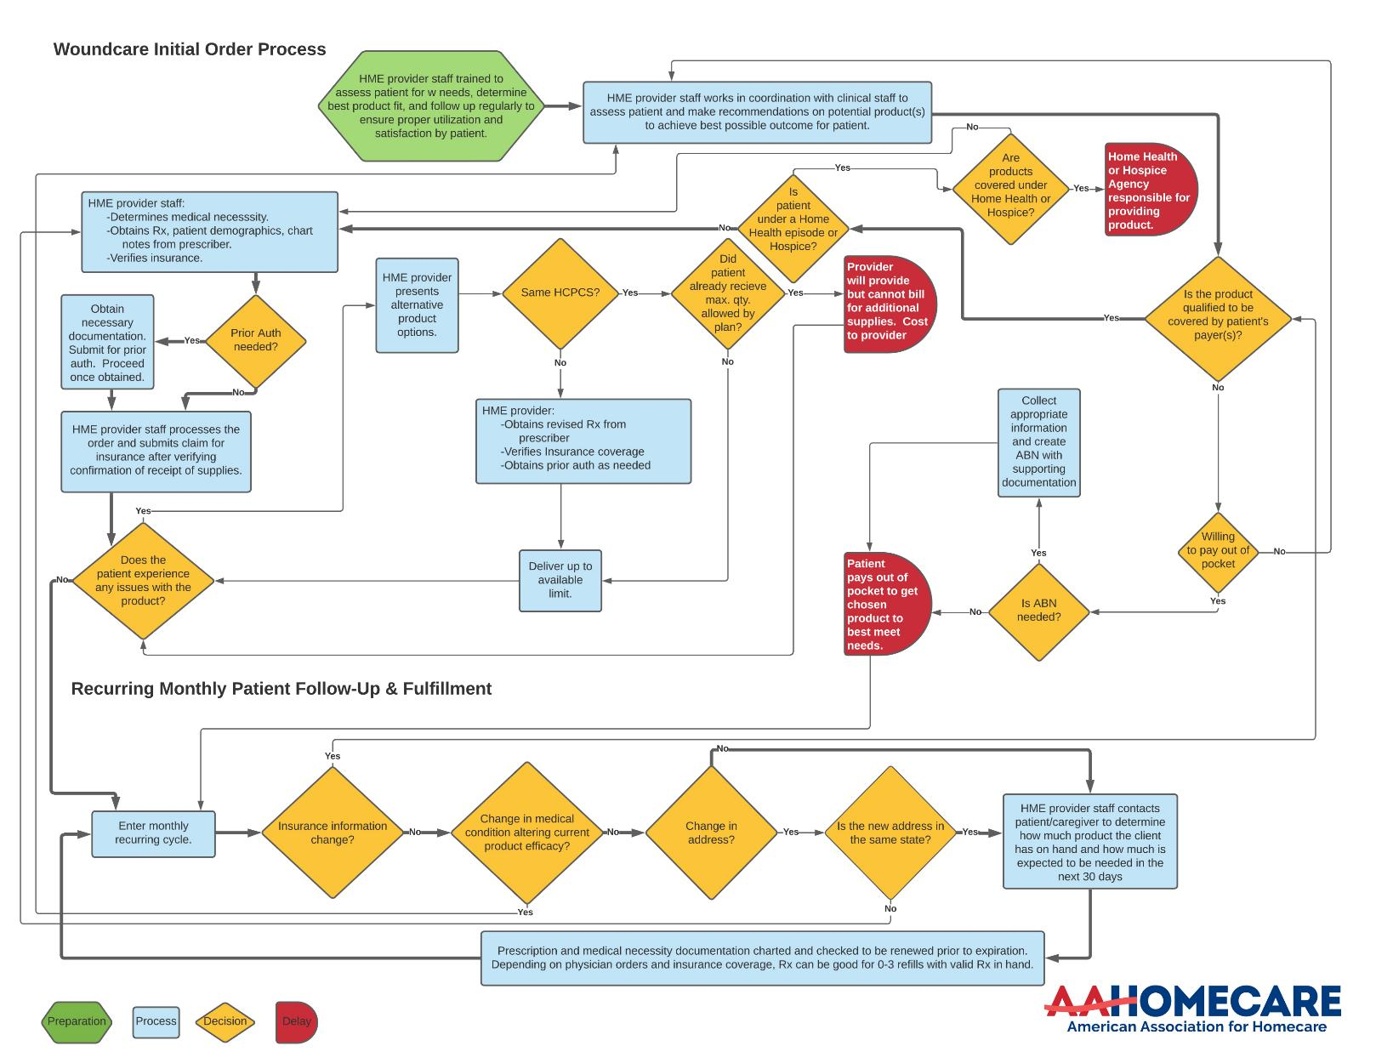
Life of an Order: Woundcare Ordering Process
Unlike a cash/Amazon transaction, HME suppliers have multiple steps to comply with payer requirements to fulfill the order.
[HME Provider] Insights:
Typical # of hours to complete an order
Average # of calls to referral to get needed information
(other info as needed)

Slide 10
Challenge 1: Cost of Goods

Slide 11
Woundcare Supplies COG Increases
Challenges with Cost of Good Increases
Supply chain constraints and access to raw materials during and after the pandemic have accelerated increases in cost of goods far above normal inflation.
A 2023 nationwide survey of HME woundcare providers indicated significant product cost increases; 59% also reported that their manufacturers/distributors have projected additional price increases this year.
When the HME provider is limited by reimbursement, it may become cost-prohibitive to provide the most clinically appropriate woundcare supplies to those who need them and/or force the HME provider to seek out less costly alternatives which may not be the ideal solution for the end user.

Slide 12
PURPOSE: To help illustrate a historical perspective of the acquisition cost of items. Cost of items reflects the direct cost of the item across spans of time.
TIP: Columns can be removed dependent on availability of data and HME Provider preference; may choose to only share the % increase and/or modify the lookback period.
HME Provider COGs View
HCPCS: | Dec 2019 | Jul 2021 | Current
AVG Cost of the Product
% Cost of the Product Increase
Fee Schedule
% Fee Schedule Increase
*call out if fee schedule increases were only caused by annual inflation increase

Slide 13
Challenge 2: Supply Chain and Shipping

Slide 14
Supply Chain Constraints: Woundcare Supplies
83% of HME providers of woundcare supplies experienced a supply chain disruption in the last 12 months
HME Provider Direct Stats (if helpful to include in addition to Industry stats, such as backorders, order cancellations, double shipments to fulfill order, etc)

Slide 15
TIP: If preferred, HME provider can replace general increase info with company-specific rate increases
Patient Home Delivery: Cost to Ship
UPS & FedEx Rate Increases
General Rate Increase (GRI)
5.9%- 2024
6.9% - 2023
5.9% - 2022
Avg 4.9% - Previous Years
*GRI does NOT include surcharges and accessorial fees.
Surcharge Increases from 2023 to 2024
Residential Deliveries:
- UPS Ground: 8.2% increase
- FedEx Home Delivery 8.4% increase
Additional surcharges for more rural routes and longer zones
Cumulative Impact: An item that costs $10 to ship in 2020 had an 18.7% increase, now costs $11.87 in 2024 before surcharges and additional rural fees
5.9% minimum additional increase in shipping costs by major carriers in effect beginning of 2024
https://www.partnership.com/blog/post/fedex-ups-general-rate-increase

Slide 16
PURPOSE: To help illustrate a historical perspective of patient home delivery shipping costs associated with disposables (WUO).
HME Provider Shipping View
Historical view of year-over-year increase in the GRI starting in 2019 through 2024.
HCPCS: | Dec 2019 | Jul 2021 | Current
AVG Shipping Cost Per Order
% Increase

Slide 17
Challenge 3: Operational Expenses

Slide 18
Increase in Disposable Supply Companies’ Labor Costs
Sources of Increased Labor Expenses:
Staying competitive from a wage perspective within the market and also accounting for inflationary cost-of-living adjustments.
Personnel time required to fulfill orders and submit claims due to sourcing alternative products, obtaining information needed from prescriber, etc.
Extensive training required for new staff, taking 6+ months on average.
Staffing shortages leading to overtime payment and staff burnout.

Slide 19
PURPOSE: To help illustrate a historical perspective of the changes within the HME Provider as it pertains to staffing challenges.
HME Provider Labor Costs View
List key insights on how HME provider has had to adapt, ex. outsourcing departments, etc.
Staffing | Dec 2019 | Jul 2021 | Current
# of Orders Per Day
Revenue per Employee

Slide 20
True Cost of an Item

Slide 21
PURPOSE: Determine the actual true cost of an item factoring in direct operational expenses of COGs, shipping, and operational expenses
Tip: Due to variance of pricing and functionality within products in these categories, consider looking at several items within the same code.
True Unit Cost Breakdown
HCPCS | Item 1 | Item 2 | Item 3
COGs (per unit)
Shipping Charge (per unit)
Operational Expense (per unit) *
Current Fee Schedule
Profitability
*Includes labor, building/lease, compliance, etc.

Slide 22
HME Provider Value

Slide 23
PURPOSE: Brag slide(s) about HME Provider
HME Provider Value Slide(s)
Explain what HME Provider does better than their competitors
Explain how HME Provider facilitates better patient outcomes
Explain the benefits to the payer (what’s in it for them) to work with HME Provider?
Connect the dots on how this emphasizes the Value of HME
Show how this helps achieve the payer’s goals (if appropriate)

Slide 24
PURPOSE: Clear & specific “asks” from payer to move towards HME Provider goals.
HME Provider Asks
List of “asks” for the payer (ex. reimbursement, policies, becoming in network provider, denial issues, communication, etc.)

Slide 25
Questions and Next Steps

Slide 26
Appendix : Life of An Order

Slide 27
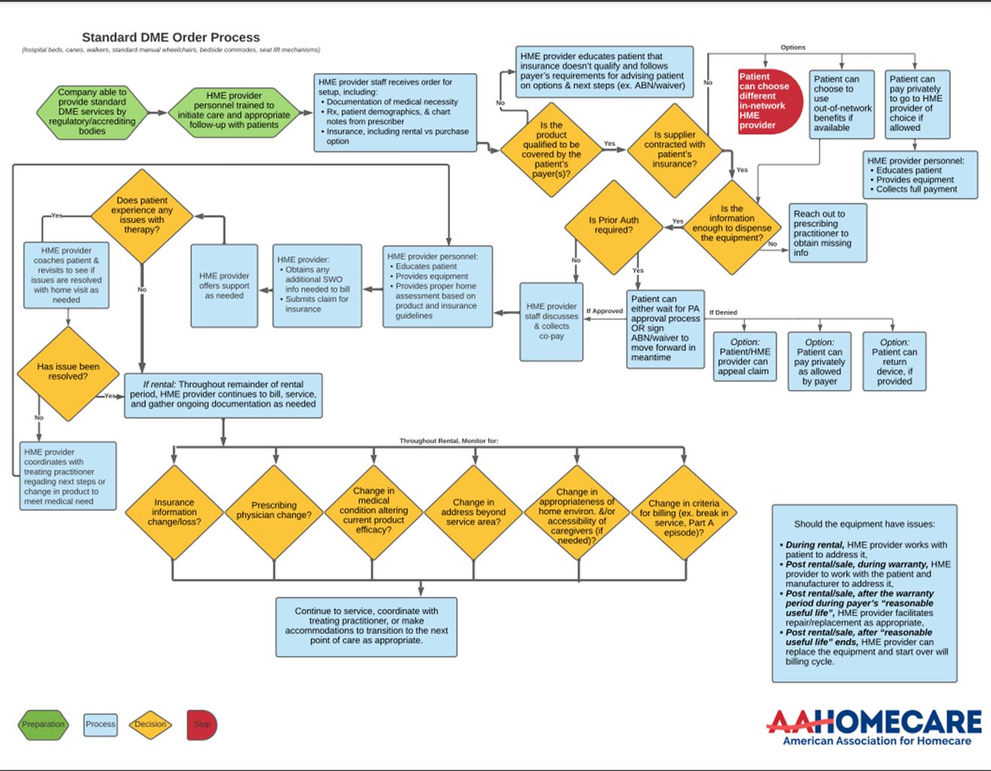
Life of an Order: Standard DME Ordering Process
Unlike a cash/Amazon transaction, HME suppliers have multiple steps to comply with payer requirements to fulfill the order.
[HME Provider] Insights:
Typical # of hours to complete an order
Average # of calls to referral to get needed information
(other info as needed)

Slide 28
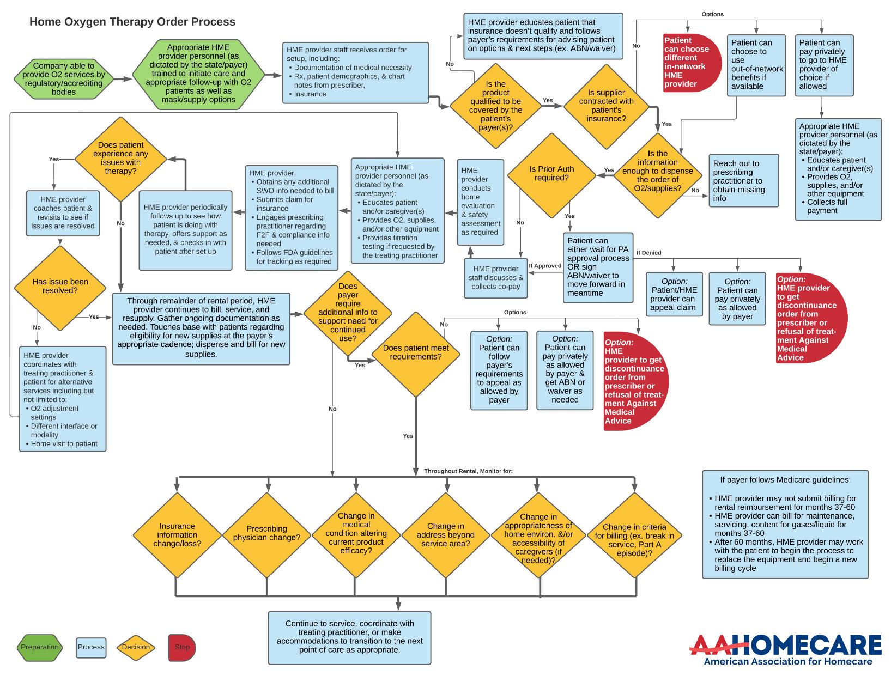
Life of an Order: O2 Equipment Process
Unlike a cash/Amazon transaction, HME suppliers have multiple steps to comply with payer requirements to fulfill the order.
[HME Provider] Insights:
Typical # of hours to complete an order
Average # of calls to referral to get needed information
(other info as needed)

Slide 29
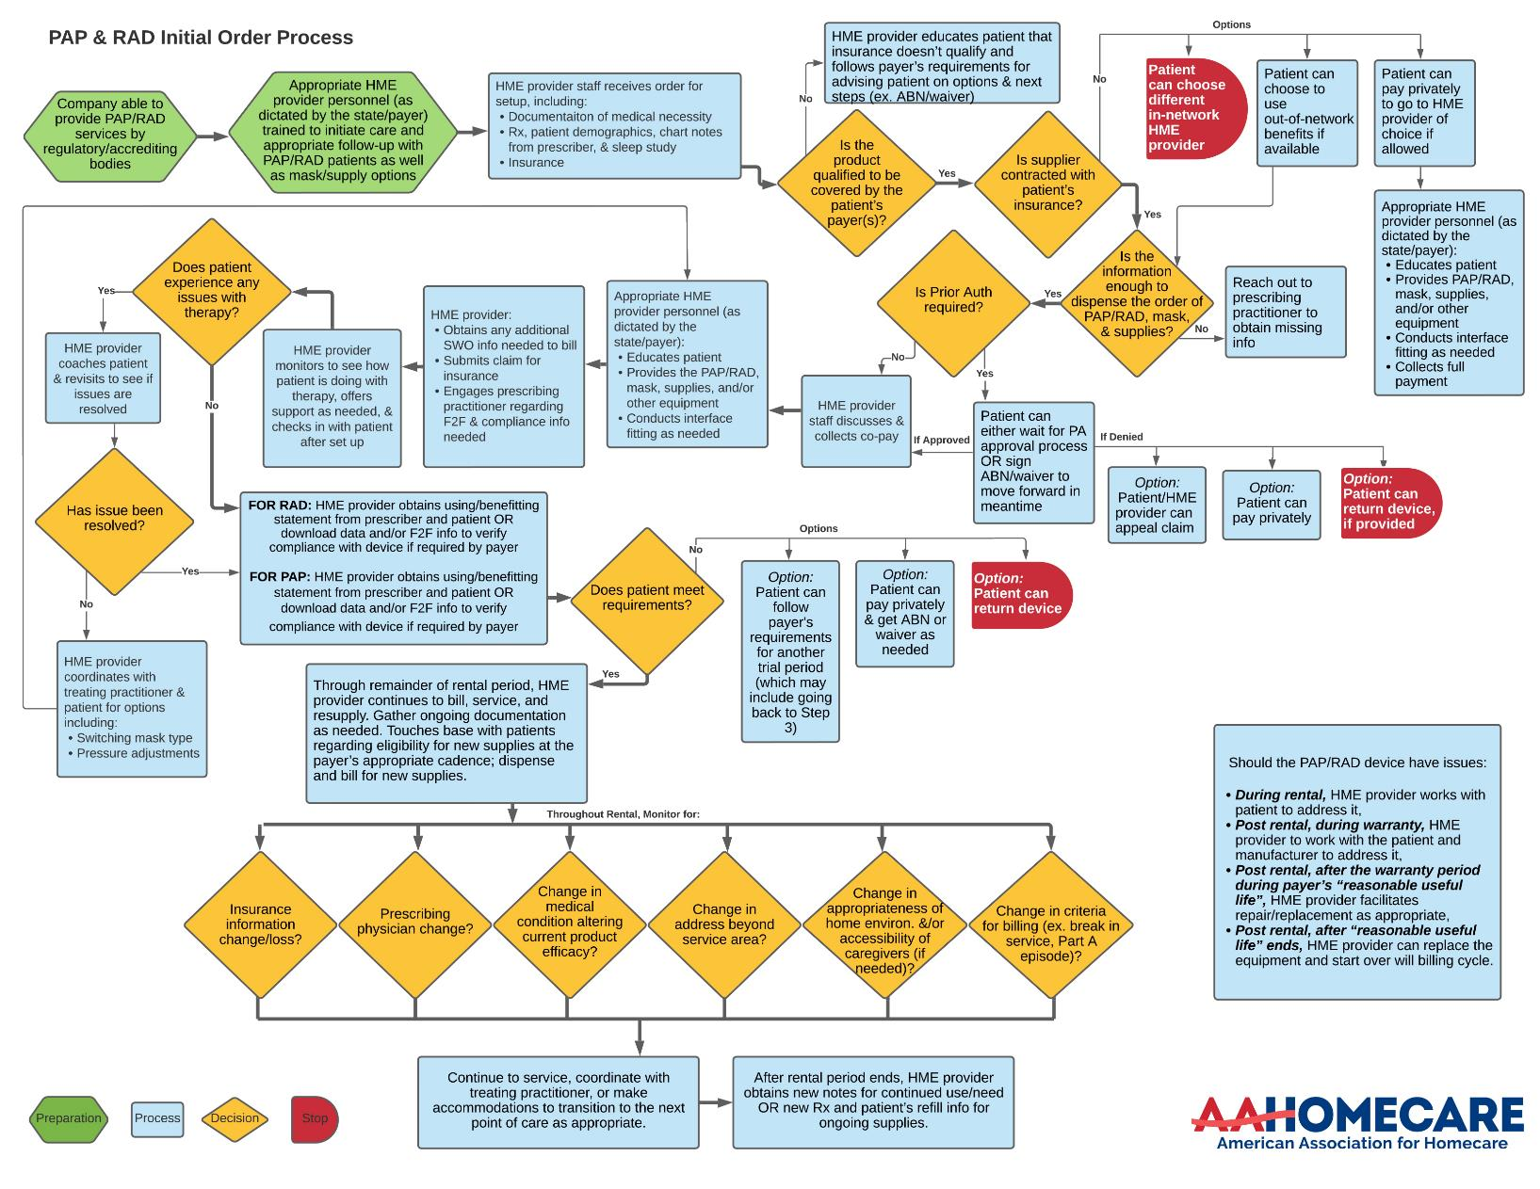
Life of an Order: CPAP & RAD Device Ordering Process
Unlike a cash/Amazon transaction, HME suppliers have multiple steps to comply with payer requirements to fulfill the order.
[HME Provider] Insights:
Typical # of hours to complete an order
Average # of calls to referral to get needed information
(other info as needed)

Slide 30
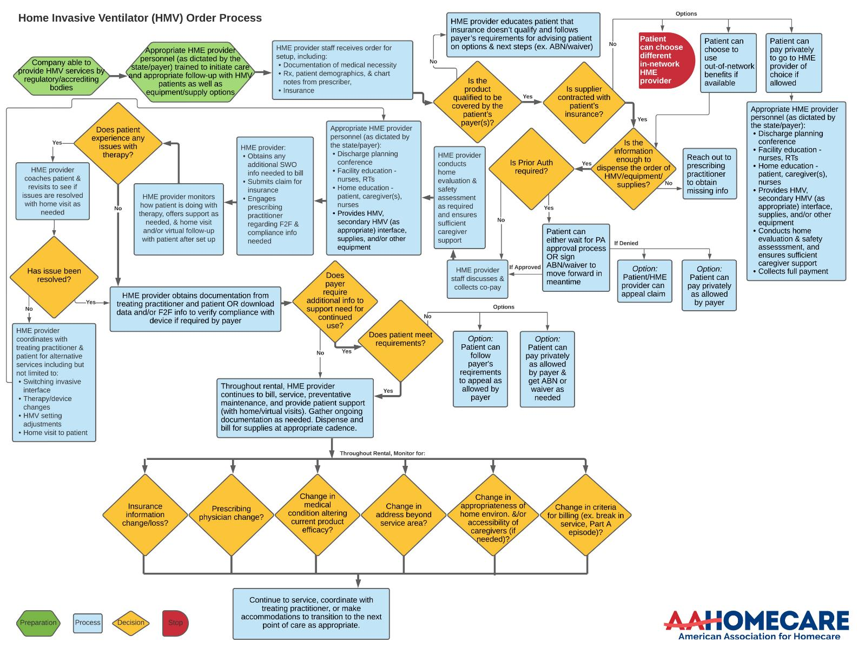
Life of an Order: Invasive Ventilator Ordering Process
Unlike a cash/Amazon transaction, HME suppliers have multiple steps to comply with payer requirements to fulfill the order.
[HME Provider] Insights:
Typical # of hours to complete an order
Average # of calls to referral to get needed information
(other info as needed)

Slide 31
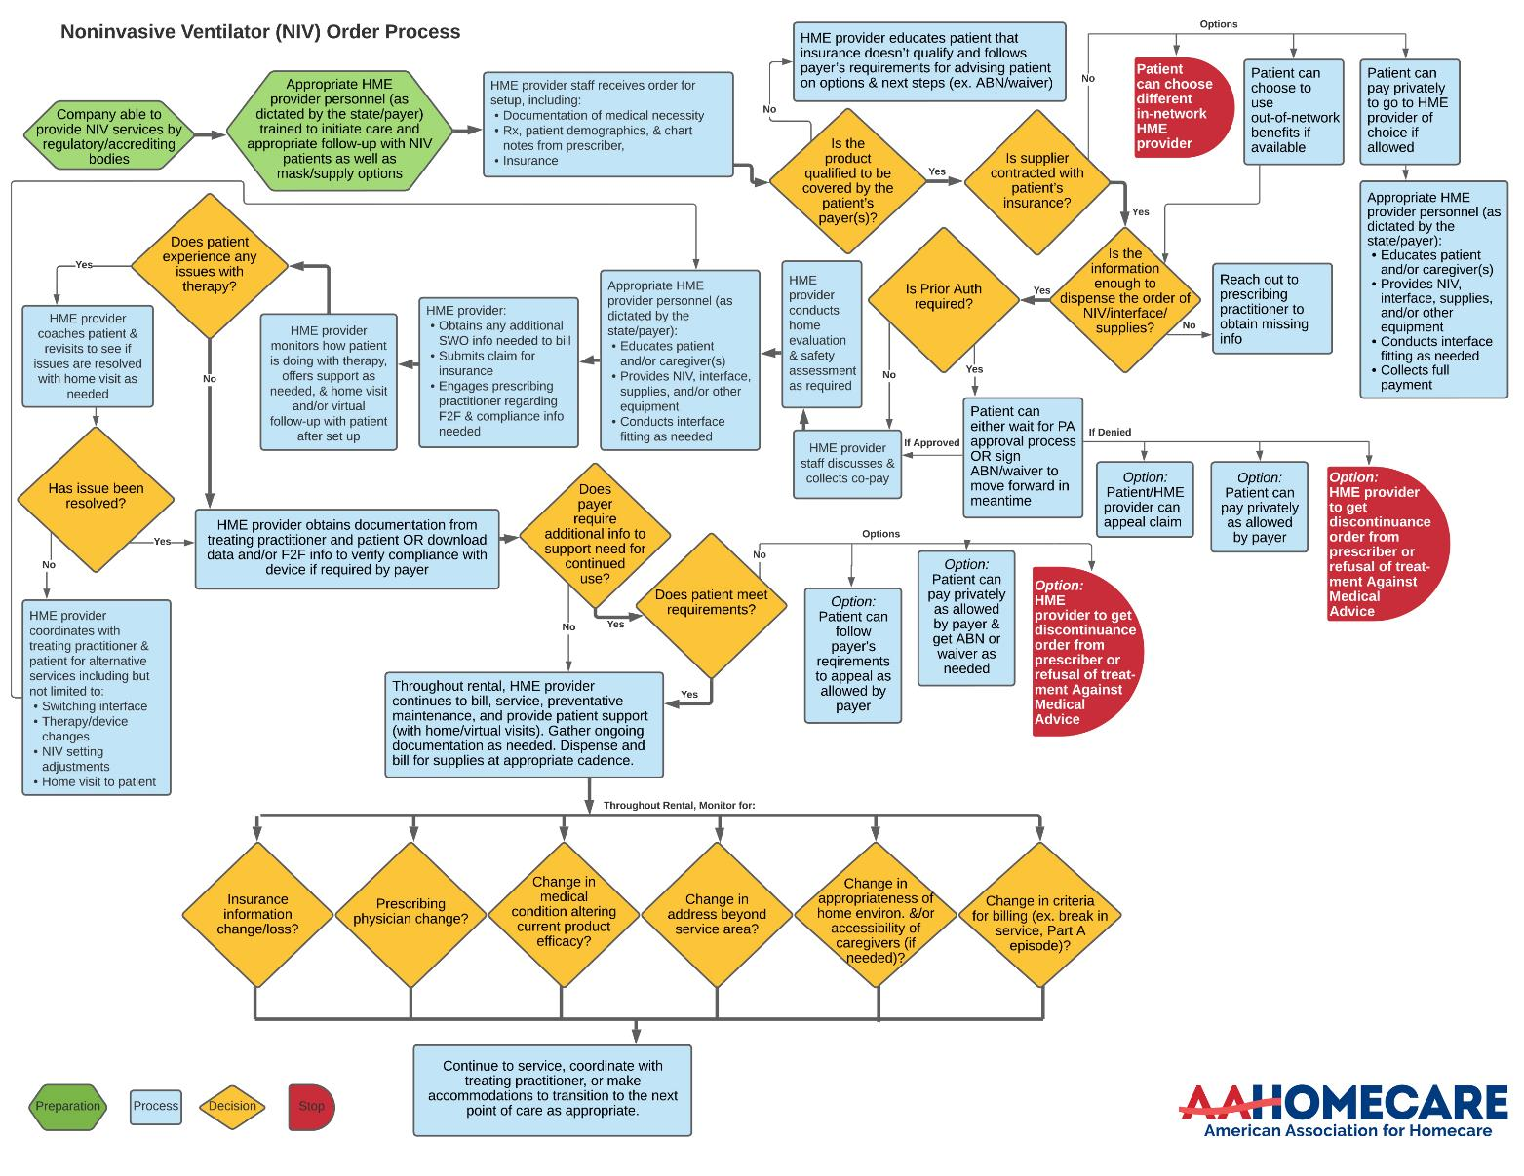
Life of an Order: Non-Invasive Ventilator Ordering Process
Unlike a cash/Amazon transaction, HME suppliers have multiple steps to comply with payer requirements to fulfill the order.
[HME Provider] Insights:
Typical # of hours to complete an order
Average # of calls to referral to get needed information
(other info as needed)

Slide 32
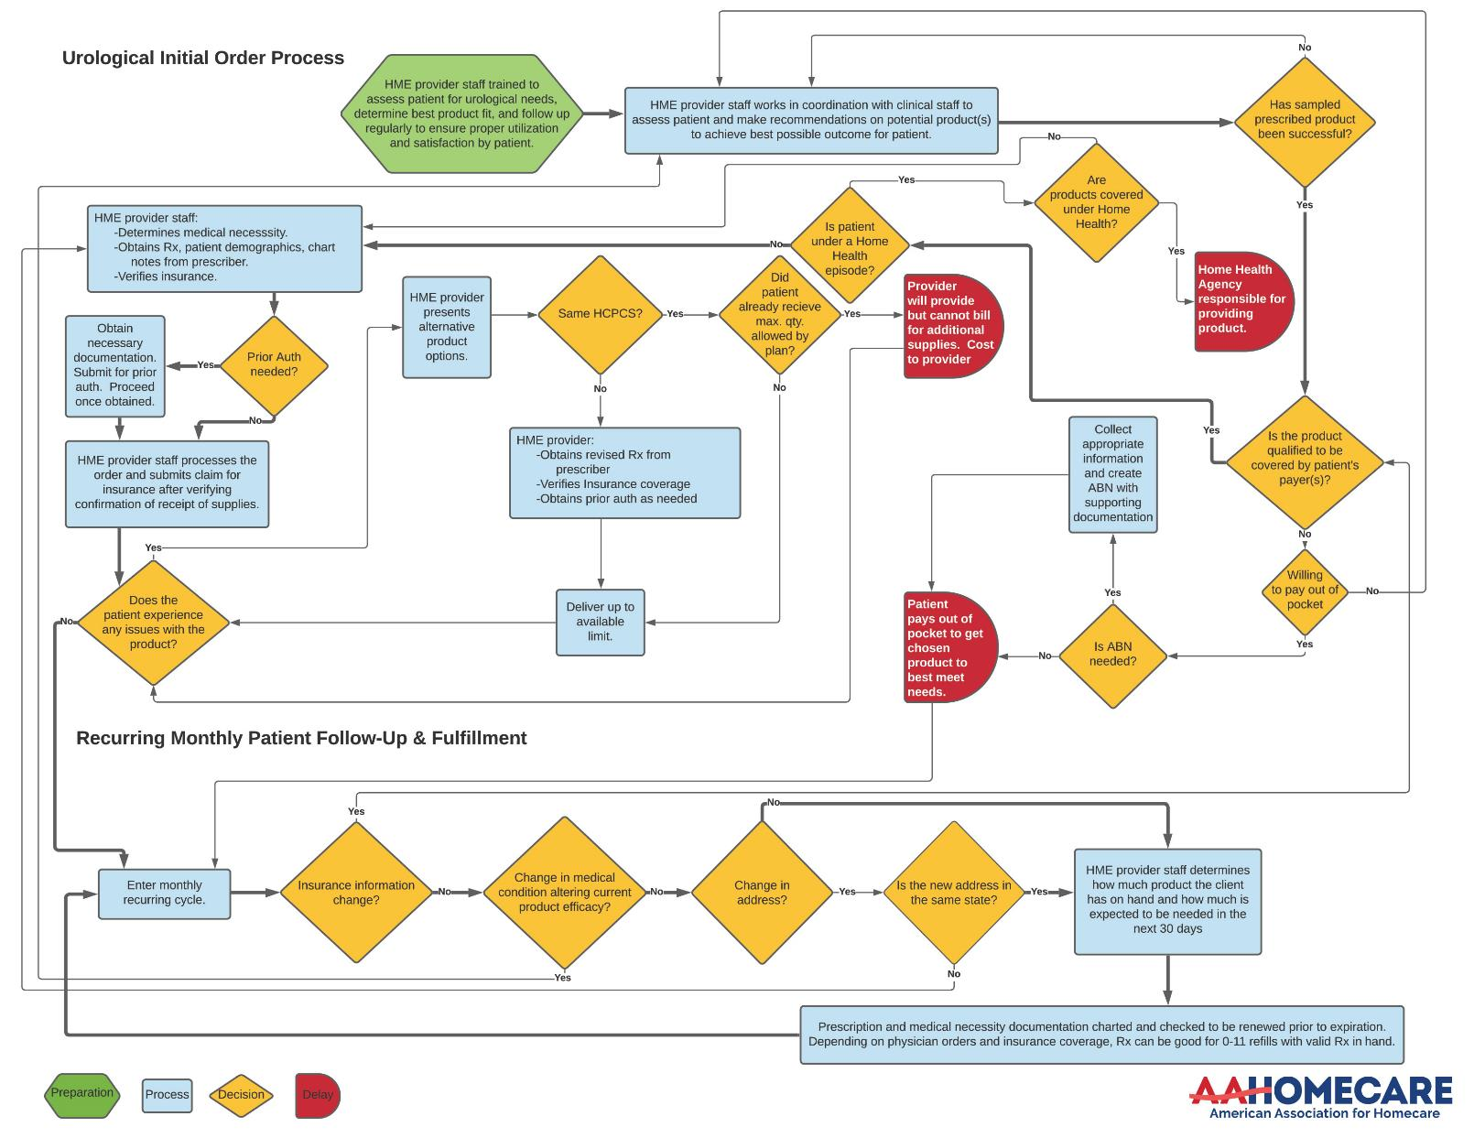
Life of an Order: Urological Supplies Ordering Process
Unlike a cash/Amazon transaction, HME suppliers have multiple steps to comply with payer requirements to fulfill the order.
[HME Provider] Insights:
Typical # of hours to complete an order
Average # of calls to referral to get needed information
(other info as needed)

Slide 33
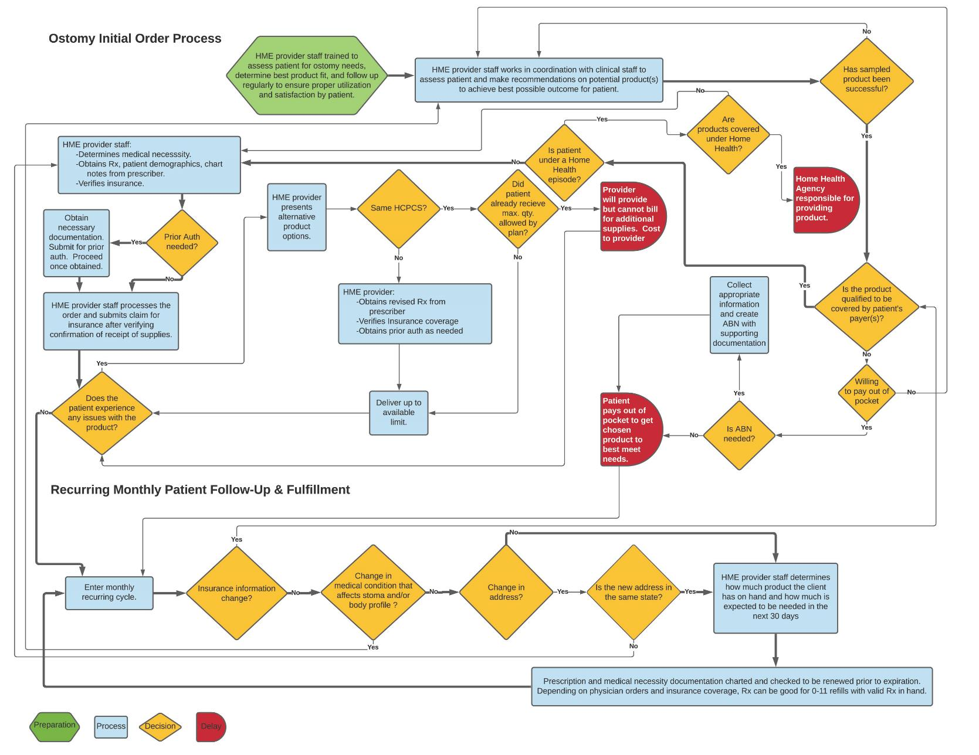
Life of an Order: Ostomy Ordering Process
Unlike a cash/Amazon transaction, HME suppliers have multiple steps to comply with payer requirements to fulfill the order.
[HME Provider] Insights:
Typical # of hours to complete an order
Average # of calls to referral to get needed information
(other info as needed)

Slide 34
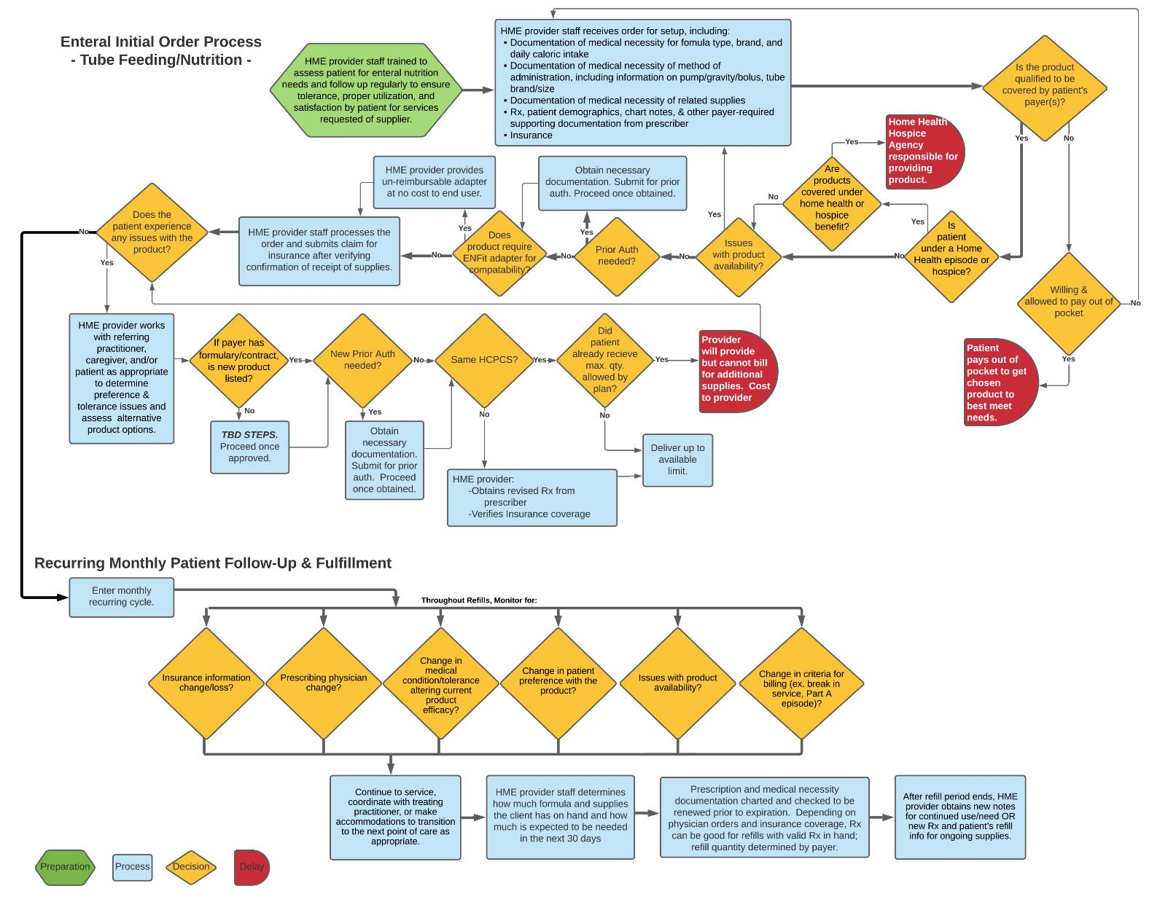
Life of an Order: Enteral Feeding/Nutrition Ordering Process
Unlike a cash/Amazon transaction, HME suppliers have multiple steps to comply with payer requirements to fulfill the order.
[HME Provider] Insights:
Typical # of hours to complete an order
Average # of calls to referral to get needed information
(other info as needed)

Slide 35
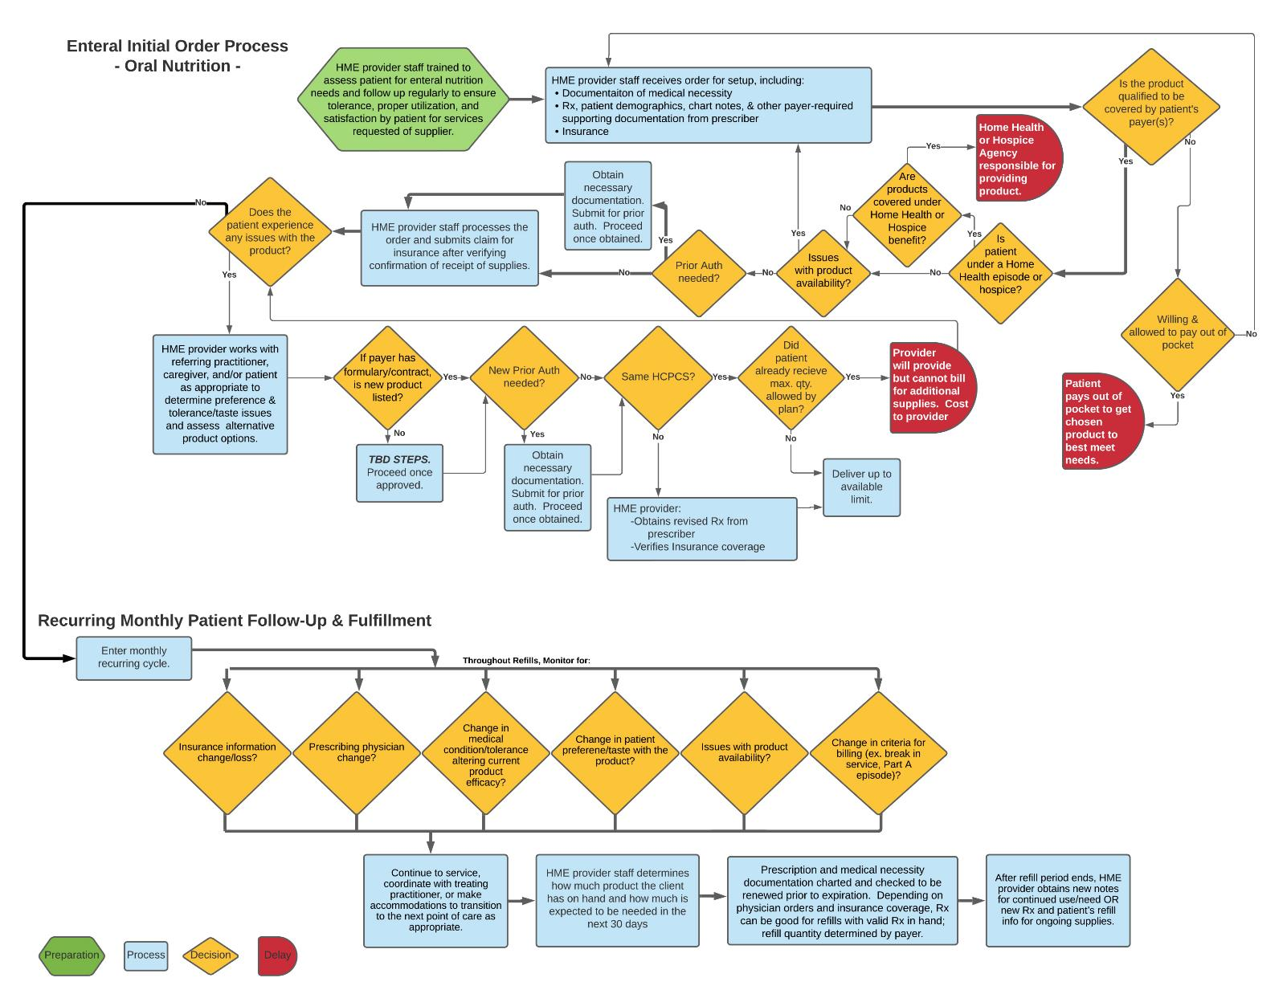
Life of an Order: Oral Enteral Nutrition Ordering Process
Unlike a cash/Amazon transaction, HME suppliers have multiple steps to comply with payer requirements to fulfill the order.
[HME Provider] Insights:
Typical # of hours to complete an order
Average # of calls to referral to get needed information
(other info as needed)

Slide 36
Appendix : COG Increases from Infographics

Slide 37
Home Oxygen Therapy COG Increases
Challenges with Cost of Good Increases
Supply chain constraints and access to raw materials during and after the pandemic have accelerated increases in cost of goods far above normal inflation.
A 2023 nationwide survey of HME O2 therapy providers indicated significant product cost increases; 64% also reported that their manufacturers/distributors have projected additional price increases this year.
When the HME provider is limited by reimbursement, it may become cost-prohibitive to provide the most clinically appropriate enteral nutrition & supplies to those who need them and/or force the HME provider to seek out less costly alternatives which may not be the ideal solution for the end user.

Slide 38
CPAP COG Increases
Challenges with Cost of Good Increases
Supply chain constraints and access to raw materials during and after the pandemic have accelerated increases in cost of goods far above normal inflation.
A 2023 nationwide survey of HME CPAP providers indicated significant product cost increases; 72% also reported that their manufacturers/distributors have projected additional price increases this year.
When the HME provider is limited by reimbursement, it may become cost-prohibitive to provide the most clinically appropriate enteral nutrition & supplies to those who need them and/or force the HME provider to seek out less costly alternatives which may not be the ideal solution for the end user.

Slide 39
Hospital Bed COG Increases
Challenges with Cost of Good Increases
Supply chain constraints and access to raw materials during and after the pandemic have accelerated increases in cost of goods far above normal inflation.
A 2023 nationwide survey of HME hospital bed providers indicated significant product cost increases; 57% also reported that their manufacturers/distributors have projected additional price increases this year.
When the HME provider is limited by reimbursement, it may become cost-prohibitive to provide the most clinically appropriate enteral nutrition & supplies to those who need them and/or force the HME provider to seek out less costly alternatives which may not be the ideal solution for the end user.

Slide 40
Enteral Nutrition, Tubes, Pumps, & Supplies COG Increases
Challenges with Cost of Good Increases
Supply chain constraints and access to raw materials during and after the pandemic have accelerated increases in cost of goods far above normal inflation.
A 2023 nationwide survey of HME enteral nutrition providers indicated significant product cost increases; 75% also reported that their manufacturers/distributors have projected additional price increases this year.
When the HME provider is limited by reimbursement, it may become cost-prohibitive to provide the most clinically appropriate enteral nutrition & supplies to those who need them and/or force the HME provider to seek out less costly alternatives which may not be the ideal solution for the end user.

Slide 41
Urology and Ostomy Supplies COG Increases
Challenges with Cost of Good Increases
Supply chain constraints and access to raw materials during and after the pandemic have accelerated increases in cost of goods far above normal inflation.
A 2023 nationwide survey of HME ostomy/urological providers indicated significant product cost increases; 61% also reported that their manufacturers/distributors have projected additional price increases this year.
When the HME provider is limited by reimbursement, it may become cost-prohibitive to provide the most clinically appropriate ostomy and urological supplies to those who need them and/or force the HME provider to seek out less costly alternatives which may not be the ideal solution for the end user.

Slide 42
PURPOSE: To help illustrate a historical perspective of the acquisition cost of items. Cost of items reflects the direct cost of the item across spans of time.
TIP: Columns can be removed dependent on availability of data and HME Provider preference; may choose to only share the % increase and/or modify the lookback period.
HME Provider COGs View
HCPCS: | Dec 2019 | Jul 2021 | Current
AVG Cost of the Product
% Cost of the Product Increase
Fee Schedule
% Fee Schedule Increase
*call out if fee schedule increases were only caused by annual inflation increase

Slide 43
Supply Chain Constraints: Oxygen Equipment
68% of HME providers of home oxygen therapy equipment experienced a supply chain disruption in the last 12 months
HME Provider Direct Stats (if helpful to include in addition to Industry stats, such as backorders, order cancellations, double shipments to fulfill order, etc)

Slide 44
Supply Chain Constraints: CPAP Devices
90% of HME providers of CPAP devices experienced a supply chain disruption in the last 12 months
HME Provider Direct Stats (if helpful to include in addition to Industry stats, such as backorders, order cancellations, double shipments to fulfill order, etc)

Slide 45
Supply Chain Constraints: Hospital Bed
56% of HME providers of hospital beds experienced a supply chain disruption in the last 12 months
HME Provider Direct Stats (if helpful to include in addition to Industry stats, such as backorders, order cancellations, double shipments to fulfill order, etc)

Slide 46
Supply Chain Constraints: Enteral Nutrition, Tubes, Pumps & Supplies
100% of HME providers of enteral nutrition & supplies experienced a supply chain disruption in the last 12 months
HME Provider Direct Stats (if helpful to include in addition to Industry stats, such as backorders, order cancellations, double shipments to fulfill order, etc)

Slide 47
Supply Chain Constraints: Ostomy/Urology Supplies
84% of HME providers of ostomy/urological supplies experienced a supply chain disruption in the last 12 months
HME Provider Direct Stats (if helpful to include in addition to Industry stats, such as backorders, order cancellations, double shipments to fulfill order, etc)

Slide 48
Appendix : Labor Cost Increases

Slide 49
Increase in Enteral Nutrition Companies’ Labor Costs
Sources of Increased Labor Expenses:
Staying competitive from a wage perspective within the market and also accounting for inflationary cost-of-living adjustments.
Personnel time required to fulfill orders and submit claims due to sourcing alternative products, obtaining information needed from prescriber, etc.
Extensive training required for new staff, taking 6+ months on average.
Staffing shortages leading to overtime payment and staff burnout.

Slide 50
Increase in HME Companies’ Labor Costs
Sources of Increased Labor Expenses:
Staying competitive from a wage perspective within the market and also accounting for inflationary cost-of-living adjustments.
Personnel time required to fulfill orders and submit claims due to sourcing alternative products, obtaining information needed from prescriber, etc.
Extensive training required for new staff, taking 6+ months on average.
Staffing shortages leading to overtime payment and staff burnout.

